Slide 1

Communication–Computation Trade–Off in Resource–Constrained Edge Inference
Jiawei Shao and Jun Zhang, “Communication–Computation Trade–off in Resource–Constrained Edge Inference, ” in IEEE Communications Magazine, vol. 58, no. 12, pp. 20–26, December 2020.
Professor: Dr. Chih-Yu Wang
Presenter: Shao–Heng Chen
Date: November 29, 2021

Slide 2

Outline
Introduction
Communication–Computation Trade–off in Edge Inference
Communication–Aware Model Compression
Task–Oriented Feature Encoding
Experiment and Evaluation
Conclusions and Future Works
References
1

Slide 3
I. Introduction
The recent breakthrough in AI, especially deep neural networks (DNNs), has affected every branch of science and technology. Particularly, edge AI has been envisioned as a major application scenario to provide DNN–based services at edge devices.
Driven by the demand for deploying DNN–based services at various edge devices, such as smartphones, wearables, and IoT devices, a new research area called edge AI emerges [1].
[1] G. Zhu et al., “Toward an Intelligent Edge: Wireless Communication Meets Machine Learning,” IEEE Commun. Mag., vol. 58, no. 1, Jan. 2020, pp. 19–25.
2

Slide 4
I. Introduction
Currently, the status quo of edge inference is either execution on the mobile devices (on–device inference) or offloading to the edge server for execution (server–based inference).
On–device inference provides limited accuracy due to the constrained resources. Some works applied model compression [2] to alleviate the huge computational complexity. But there is a 10% gap between the state–of–the-art mobile model and the best model [3].
[2] Y. Cheng et al., “Model Compression and Acceleration for Deep Neural Networks: The Principles, Progress, and Challenges,” IEEE Signal Processing Mag., vol. 35, no. 1, 2018, pp. 126–36.
[3] H. Cai et al., “Once for All: Train One Network and Specialize It for Efficient Deployment,” Int’l. Conf. Learning Representations, 2020.
3

Slide 5
I. Introduction
On the other hand, server–based inference induces excessive communication overhead, making it challenging to support latency–sensitive applications like self–driving cars. And it also suffers from the data privacy issue.
Thus, the limited computation resource and the excessive communication overhead form bottlenecks for on–device inference and server–based inference.
4

Slide 6
I. Introduction
The main contributions of this article are summarized as:
(1) Investigates the communication–computation trade–off in device–edge co–inference.
(2) Proposes a general three–step framework to reduce the co–inference latency in
supervised tasks.
(3) Adopt an incremental network pruning method to reduce the redundant weights
and computation latency while alleviating the communication overhead.
5

Slide 7
I. Introduction
The main contributions of this article are summarized as:
(4) Use a two–step feature encoding to reduce the communication latency by learning
a compact representation.
(5) Conduct experiments based on the classification task that evidence the proposed
framework’s advantages in striking a better communication–computation trade–
off and reducing the edge inference latency.
6

Slide 8
II. Com.–Compu. Trade–off in Edge Inference
A. Communication–Computation Trade–off and Model Splitting
Many edge devices are with limited computing capability due to low–end processing units and limited communication capability caused by the limited bandwidth.
As the DNN gradually abstract the intermediate feature [4] in supervised tasks, the low– latency edge inference can be achieved by carefully selecting the split point to control the on–device model size and its output dimension.
Split point selection provides a rudimentary way for communication–computation trade–off.
[4] N. Tishby and N. Zaslavsky, “Deep Learning and the Information Bottleneck Principle,” 2015 IEEE Info. Theory Wksp., 2015, pp. 1–5.
7

Slide 9
II. Com.–Compu. Trade–off in Edge Inference
B. Communication–Aware Model Compression for Better Trade–Off
There have been edge–based methods that deployed large models on resource–constrained devices by aggressive compression or knowledge distillation. However, the over compressed model may lead to intolerant performance loss.
For edge–device co–inference, the 2–step pruning method [5] used the iterative pruning workflow to compress the whole neural network.
[5] W. Shi et al., “Improving Device-Edge Cooperative Inference of Deep Learning Via 2-Step Pruning,” arXiv preprint arXiv:1903.03472, 2019.
8

Slide 10
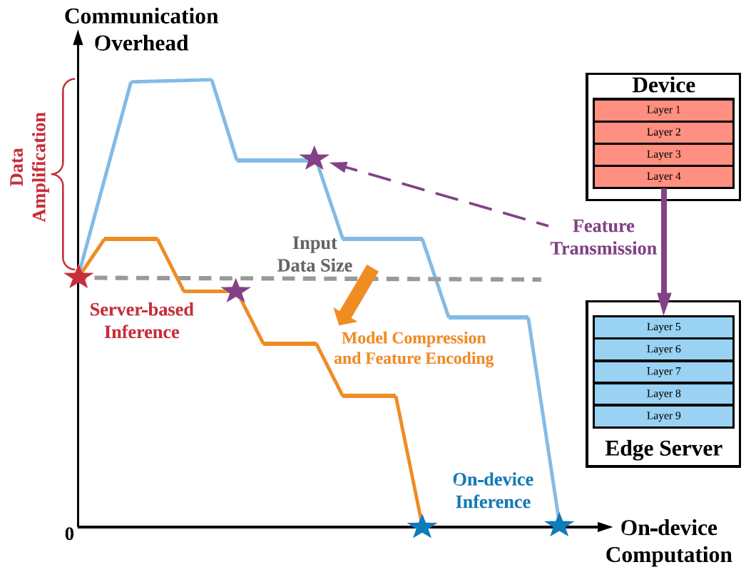
II. Com.–Compu. Trade–off in Edge Inference
C. Task–Oriented Feature Encoding for Better Trade–Off
There is a data amplification effect [6] in DNN. Optimally, the transmitted feature should only contain a minimal amount of information that is sufficient for the inference task.
[6] H. Li et al., “Jalad: Joint Accuracy-and Latency-Aware Deep Structure Decoupling for Edge-Cloud Execution,” 2018 IEEE 24th Int’l. Conf. Parallel and Distributed Systems, 2018, pp. 671–78.
9

Slide 11
II. Com.–Compu. Trade–off in Edge Inference
C. Task–Oriented Feature Encoding for Better Trade–Off
The additional feature encoder is implemented by a lightweight DNN that is trained together with other layers. Many related works, e.g., BottleNet++ [7], JALAD [6], utilized traditional coding methods like Huffman coding and JPEG for edge-device co–inference.
The main difference between the task–oriented encoding and traditional coding techniques is that the traditional methods aim to reconstruct the data in the receiver. However, task–oriented encoding allows discarding plenty of information unrelated to the task.
[7] J. Shao and J. Zhang, “Bottlenet++: An End-to-End Approach for Feature Compression in Device–Edge Co–Inference Systems,” 2020 IEEE ICC Wksps., 2020, pp. 1–6.
[6] H. Li et al., “Jalad: Joint Accuracy–and Latency–Aware Deep Structure Decoupling for Edge–Cloud Execution,” 2018 IEEE 24th Int’l. Conf. Parallel and Distributed Systems, 2018, pp. 671–78.
10

Slide 12
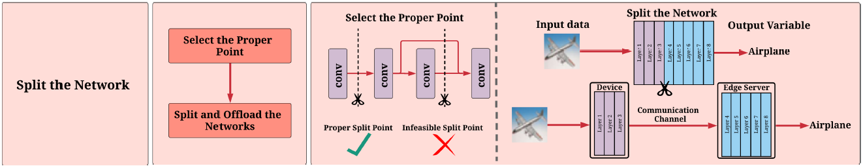
II. Com.–Compu. Trade–off in Edge Inference
D. Framework Overview
Based on the above discussion, this article proposes a general framework, which combines three techniques, namely model splitting, model compression, and feature encoding.
The workflow consists of three steps:
(1) First, choose a split point that does not highly suffer from the data amplification effect.
11

Slide 13
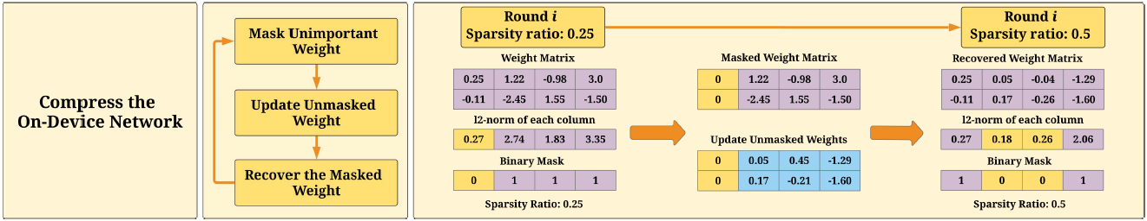
II. Com.–Compu. Trade–off in Edge Inference
D. Framework Overview
The workflow consists of three steps:
(2) Second, use the model compression method to prune the redundant weights incrementally.
12

Slide 14
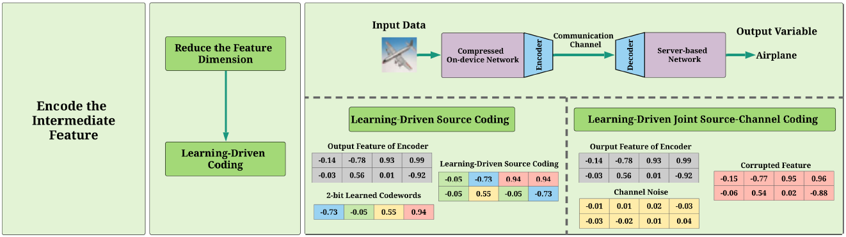
II. Com.–Compu. Trade–off in Edge Inference
D. Framework Overview
The workflow consists of three steps:
(3) Third, use the feature encoding to compress the intermediate data with acceptable
performance degradation.
13

Slide 15
III. Communication–Aware Model Compression
A. Model Compression for DNNs
First introduces conventional methods for DNN model compression. These methods can be categorized into four schemes, aggressive compressions like parameter pruning, low-rank factorization, compact convolutional filters, and knowledge distillation.
Generally, many works on edge inference [5] applied parameter pruning as it is robust and flexible. These parameter pruning methods have less constraints on the network structure and limited extra computational cost.
[5] W. Shi et al., “Improving Device-Edge Cooperative Inference of Deep Learning Via 2-Step Pruning,” arXiv preprint arXiv:1903.03472, 2019.
14

Slide 16
III. Communication–Aware Model Compression
B. Communication–Aware Model Compression
Model compression for device-edge co–inference should account for both the on–device computational cost and the resulting communication overhead.
There are two categories of pruning: unstructured pruning and structured pruning [8].
(1) The unstructured pruning aims to prune individual unimportant weight and can
achieve a high sparsity ratio. However, the pruned weight matrices with irregular
sparsity may not be helpful for matrix multiplication acceleration.
[8] E. Bourtsoulatze, D. B. Kurka, and D. Gunduz, “Deep Joint Source-Channel Coding for Wireless Image Transmission,” IEEE Trans. Cognitive Commun. and Networking, 2019.
15

Slide 17
III. Communication–Aware Model Compression
B. Communication–Aware Model Compression
There are two categories of pruning: unstructured pruning and structured pruning [8].
(2) The structured pruning accelerate the DNN by obtaining regular sparsity pattern
(e.g., channel-wise pruning, kernel-wise pruning).
Besides, this article use the activation pruning to prune the individual neuron in the
last layer of the on-device network to reduce the communication overhead.
[8] E. Bourtsoulatze, D. B. Kurka, and D. Gunduz, “Deep Joint Source-Channel Coding for Wireless Image Transmission,” IEEE Trans. Cognitive Commun. and Networking, 2019.
16

Slide 18
III. Communication–Aware Model Compression
C. Incremental Network Pruning
In this framework, they use incremental network pruning. It is a magnitude–based pruning during training method similar to [8]. It can reach a high compression ratio with limited performance loss.
The iterative pruning process in training consist of three steps in each iteration will be explained below.
[8] E. Bourtsoulatze, D. B. Kurka, and D. Gunduz, “Deep Joint Source-Channel Coding for Wireless Image Transmission,” IEEE Trans. Cognitive Commun. and Networking, 2019.
17

Slide 19
III. Communication–Aware Model Compression
C. Incremental Network Pruning
The pruning process consist of three steps in each iteration:
(1) Sort the weights corresponding to each output channel based on their l2–norm.
The smallest Si% of weights will be masked in this iteration, where Si% is the
corresponding sparsity ratio.
(2) In the forward–propagation, the masked weights’ values are set to 0, and only
the unmasked weights will be updated in the back–propagation.
18

Slide 20
III. Communication–Aware Model Compression
C. Incremental Network Pruning
The pruning process consist of three steps in each iteration:
(3) The mask is deleted, and masked weights are recovered to their original values at
the beginning of this iteration. Then our method starts the next iteration.
The sparsity ratio in each iteration will continuously increase until it reaches the desired ratio, and this mechanism makes the pruning process stable [9].
[9] Baldassarre, L., Pontil, M., & Mourão-Miranda, J. (2017). “Sparsity is better with stability: Combining accuracy and stability for model selection in brain decoding. ” Frontiers in neuroscience, 11, 62.
19

Slide 21
IV. Task-Oriented Feature Encoding
A. Communication-Oriented vs. Task–Oriented Feature Encoding
The communication-oriented methods aim to recover the data, either perfectly (lossless coding) or with tolerable distortion (lossy coding).
There are many hand-crafted coding methods to compress the data in traditional communication, including source coding (e.g., Huffman coding, PNG, JPEG) and joint source-channel coding. Besides, recent works applied DNNs in feature encoding for data transmission, e.g., NECST [10] and DeepJSCC [11].
[10] M. Zhu and S. Gupta, “To Prune, or Not to Prune: Exploring the Efficacy of Pruning for Model Compression,” Int’l. Conf. Learning Representations, 2018.
[11] K. Choi et al., “Neural Joint Source-Channel Coding,” Int’l. Conf. Machine Learning, 2019, pp. 1182–92.
20

Slide 22
IV. Task-Oriented Feature Encoding
A. Communication–Oriented vs. Task–Oriented Feature Encoding
On the contrast, task-oriented encoding can achieve latency reduction for two reasons:
(1) Data recovery is unnecessary, and unnecessary information can be discarded, which
adapts to the feature distribution and is trained based on a target objective.
(2) Due to DNNs’ fault-tolerant property, although the received data is corrupted by
over–compression or channel noise, the performance would not severely degrade [7].
[7] J. Shao and J. Zhang, “Bottlenet++: An End-to-End Approach for Feature Compression in Device-Edge Co-Inference Systems,” 2020 IEEE ICC Wksps., 2020, pp. 1–6.
21

Slide 23
IV. Task-Oriented Feature Encoding
B. Two–Step Feature Encoding
This article propose a two–step encoding method:
(1) Dimension Reduction. Inspired by the recent work using the auto–encoder structure
for communication [7], they use a pair of lightweight complementary encoder and
decoder (with less than 1% additional computational cost compared with the original
network) to reduce the data dimension.
[7] J. Shao and J. Zhang, “Bottlenet++: An End-to-End Approach for Feature Compression in Device-Edge Co-Inference Systems,” 2020 IEEE ICC Wksps., 2020, pp. 1–6.
22

Slide 24
IV. Task-Oriented Feature Encoding
B. Two–Step Feature Encoding
This article propose a two–step encoding method:
(2) Learning–Driven Coding. In the second step, the DNN learns the mapping from
source symbols to codewords.
In this article, they provide two alternative coding methods: learning-driven
source coding and learning–driven joint source–channel coding (JSCC).
23

Slide 25
IV. Task-Oriented Feature Encoding
B. Two–Step Feature Encoding
Learning–Driven Source Coding: The DNN learns a set of optimal discrete codewords for the lossy compression, rather than using traditional methods like rounding or truncation with pre–defined codewords.
Learning–Driven Joint Source–Channel Coding: The coding schemes model a noisy channel as a non-trainable layer in the DNN, which can reduce the redundancy compared with the separate channel coding.
24

Slide 26
V. Experiment and Evaluation
A. Experimental Setup
Dataset and Neural Network: They evaluate their proposed framework on an image classification task with the CIFAR-10 dataset [12], and use the classical ResNet18 [13] as the classifier.
Metric: One important metric is classification accuracy, and they set the accuracy threshold to 93% in edge inference. Another important metric is the end-to-end latency, which is mainly influenced by the on-device computation and communication overhead.
[12] A. Krizhevsky et al., “Learning Multiple Layers of Features from Tiny Images,” Citeseer, Tech. Rep., 2009.
[13] K. He et al., “Deep Residual Learning for Image Recognition,” Proc. IEEE Conf. Computer Vision and Pattern Recognition, 2016, pp. 770–78.
25

Slide 27
V. Experiment and Evaluation
A. Experimental Setup
Baselines: To the best of our knowledge, there has been no systematic study of the communication-computation trade-off in device-edge co-inference. In order to fully illustrate this trade-off and verify the effectiveness of their framework, they consider three baselines:
(1) The original network with split point selection, but without model or feature compression
(2) The 2-Step Pruning method [5], where the first step prunes the entire DNN and the second step only prunes the layer right before the split point.
[5] W. Shi et al., “Improving Device-Edge Cooperative Inference of Deep Learning Via 2-Step Pruning,” arXiv preprint arXiv:1903.03472, 2019.
26

Slide 28
V. Experiment and Evaluation
A. Experimental Setup
The three considered baselines:
(3) BottleNet++ [7], which uses an auto-encoder to compress the intermediate data.
As BottleNet++ and their method using DNNs to encode the feature, Huffman coding is used in the original network and the 2-Step Pruning method for a fair comparison.
Besides, they use the PNG method for input image compression, corresponding to the server-based method’s communication overhead.
[7] J. Shao and J. Zhang, “Bottlenet++: An End-to-End Approach for Feature Compression in Device-Edge Co-Inference Systems,” 2020 IEEE ICC Wksps., 2020, pp. 1–6.
27

Slide 29
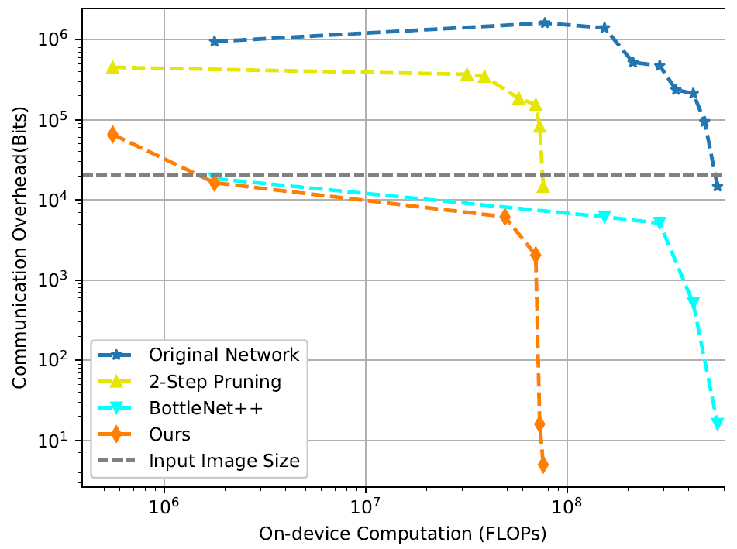
V. Experiment and Evaluation
B. Communication–Computation Trade–Off
First, from an overall perspective, the closer to the lower-left, the better to the trade-off.
Next, from the data amplification perspective [6]. The grey dashed line is the communication overhead for transmitting the input data.
[6] H. Li et al., “Jalad: Joint Accuracy-and Latency-Aware Deep Structure Decoupling for Edge-Cloud Execution,” 2018 IEEE 24th Int’l. Conf. Parallel and Distributed Systems, 2018, pp. 671–78.
28

Slide 30
V. Experiment and Evaluation
C. Edge Inference Speedup
This part provides a real-world case study to compare the end-to-end latency.
Edge device: Raspberry Pi 3 (1GB RAM and 24GFLOP/s).
Edge server: RTX 2080 TI (11GB RAM and 13.45 TFLOP/s).
ML Framework: PyTorch, and the original network ResNet18 needs more than 0.9 GB memory. They can roughly deploy 40% of the uncompressed model and 90% of the compressed model on the Raspberry.
29

Slide 31
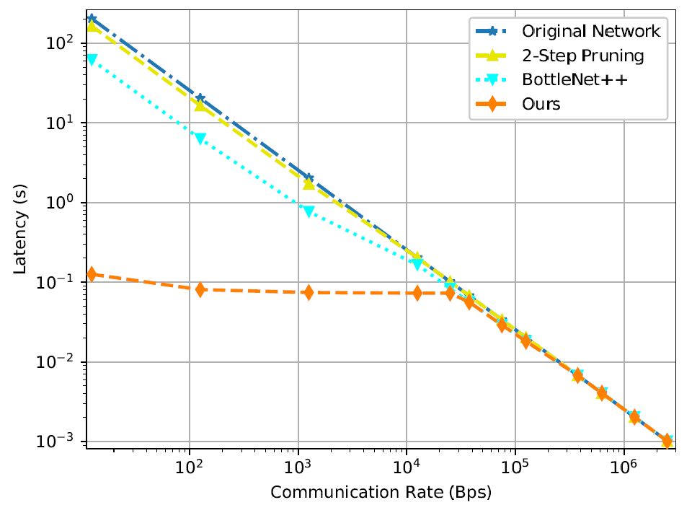
V. Experiment and Evaluation
C. Edge Inference Speedup
Even under a poor communication environment (smaller than 40 KBps), the proposed method can still maintain the inference latency around 0.1 sec.
30

Slide 32
V. Experiment and Evaluation
D. Performance of Learning–Driven JSCC over Noisy Channels
Previous simulations assumed error–free transmission of the intermediate feature. In this part, they consider noisy channels and verify the effectiveness of the learning–driven JSCC scheme for feature encoding.
Two kinds of noisy channels are considered, namely, an AWGN channel and a Binary Symmetric Channel (BSC)
Note that JSCC does not need extra channel coding, and they assume perfect channel coding for other methods.
31

Slide 33
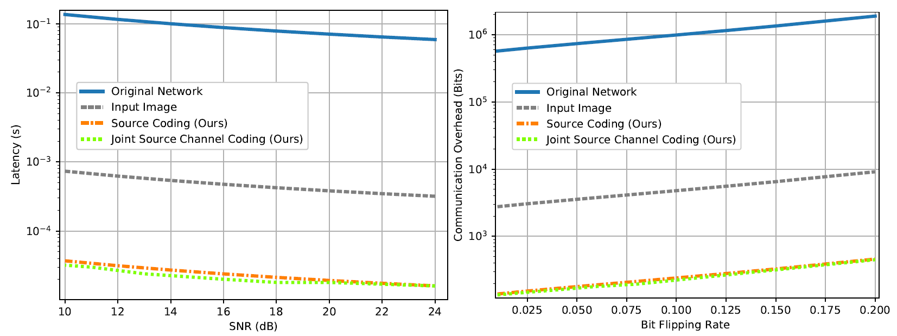
V. Experiment and Evaluation
D. Performance of Learning–Driven JSCC over Noisy Channels
32

Slide 34
VI. Conclusion
This article investigate the communication-computation trade-off in edge inference.
And propose a general three step framework for supervised tasks.
Which incorporates three techniques, i.e., model splitting, model compression, and feature encoding to reduce the end-to-end latency in co-inference.
Simulations based on the classification task verify that this framework achieved a better communication-computation trade-off and much lower latency than other baselines.
33

Slide 35
VI. Future Works
While promising results have been demonstrated, the proposed method also has some limitations.
First, the incremental network pruning method requires manual setup for the sparsity ratio in each iteration, and the pruning during training approach requires many iterations to coverage.
Second, the feature encoding scheme uses extra DNNs that introduce an additional computational cost. Designing a lightweight DNN that maintains a trade-off between extra computation and the data compression ratio becomes essential.
34

Slide 36
VI. Future Works
Third, the hyper-parameters in the framework (split position, model sparsity ratio, and data compression ratio) probably are manually tuned.
And possibly required a brute force search to find the candidate model in different edge environments. This off-line search process is time-consuming.
35

Slide 37
VI. Future Works
Suggestions from the author:
(1) The neural architecture search (NAS) technique [3] can be applied for searching the hardware-accelerated and communication-aware DNNs for edge deployment, rather than the hand-crafted models.
(2) To further reduce the communication overhead, information theory can be leveraged to design the feature encoder. Like adding an entropy constraint for source coding and a mutual information constraint for JSCC.
(3) Searching the optimal hyper-parameters by reinforcement learning is a promising direction to explore.
[3] H. Cai et al., “Once for All: Train One Network and Specialize It for Efficient Deployment,” Int’l. Conf. Learning Representations, 2020.
36

Slide 38
VII. References
Jiawei Shao and Jun Zhang, “Communication–Computation Trade–off in Resource–Constrained Edge Inference, ” in IEEE Communications Magazine, vol. 58, no. 12, pp. 20–26, December 2020.
[1] G. Zhu et al., “Toward an Intelligent Edge: Wireless Communication Meets Machine Learning,” IEEE Commun. Mag., vol. 58, no. 1, Jan. 2020, pp. 19–25.
[2] Y. Cheng et al., “Model Compression and Acceleration for Deep Neural Networks: The Principles, Progress, and Challenges,” IEEE Signal Processing Mag., vol. 35, no. 1, 2018, pp. 126–36.
[3] H. Cai et al., “Once for All: Train One Network and Specialize It for Efficient Deployment,” Int’l. Conf. Learning Representations, 2020.
[4] N. Tishby and N. Zaslavsky, “Deep Learning and the Information Bottleneck Principle,” 2015 IEEE Info. Theory Wksp., 2015, pp. 1–5.
[5] W. Shi et al., “Improving Device-Edge Cooperative Inference of Deep Learning Via 2-Step Pruning,” arXiv preprint arXiv:1903.03472, 2019.
[6] H. Li et al., “Jalad: Joint Accuracy–and Latency–Aware Deep Structure Decoupling for Edge–Cloud Execution,” 2018 IEEE 24th Int’l. Conf. Parallel and Distributed Systems, 2018, pp. 671–78.
37

Slide 39
VII. References
[7] J. Shao and J. Zhang, “Bottlenet++: An End-to-End Approach for Feature Compression in Device–Edge Co–Inference Systems,” 2020 IEEE ICC Wksps., 2020, pp. 1–6.
[8] E. Bourtsoulatze, D. B. Kurka, and D. Gunduz, “Deep Joint Source-Channel Coding for Wireless Image Transmission,” IEEE Trans. Cognitive Commun. and Networking, 2019.
[9] Baldassarre, L., Pontil, M., & Mourão-Miranda, J. (2017). “Sparsity is better with stability: Combining accuracy and stability for model selection in brain decoding. ” Frontiers in neuroscience, 11, 62.
[10] M. Zhu and S. Gupta, “To Prune, or Not to Prune: Exploring the Efficacy of Pruning for Model Compression,” Int’l. Conf. Learning Representations, 2018.
[11] K. Choi et al., “Neural Joint Source-Channel Coding,” Int’l. Conf. Machine Learning, 2019, pp. 1182–92.
[12] A. Krizhevsky et al., “Learning Multiple Layers of Features from Tiny Images,” Citeseer, Tech. Rep., 2009.
[13] K. He et al., “Deep Residual Learning for Image Recognition,” Proc. IEEE Conf. Computer Vision and Pattern Recognition, 2016, pp. 770–78.
38

